Slide 1


VibandaConnect: Empowering Local Vendors with Digital Order Management
by Hanan M. Yusuf

Slide 2
Problem Statement
Overview
1
Small-scale vendors ("mama wa vibanda") lack efficient order management, delivery coordination, and digital systems.
2
Inefficient Order Management
Vendors struggle with manual order taking, leading to errors and delays.
Delivery Logistics Coordination
3
Coordinating deliveries is challenging due to lack of proper systems and communication.
4
Lack of Accessible Digital Systems
Vendors often lack access to the digital tools needed to operate efficiently.
These challenges limit customer base, cause delays, and reduce operational efficiency.

Slide 3

Solution
Solution Summary
How It Works
VibandaConnect is a simple, intuitive database-driven web application that allows vendors to manage their inventory, process customer orders, and collaborate with motorcyclists and cyclists for delivery.
Vendors can view and update inventory. Customers place orders via a web interface. Motorcyclists and cyclists get notified of orders for prompt delivery.
Goal
Provide a practical solution that’s easy to use and can be adopted even by vendors with minimal digital literacy.

Slide 4
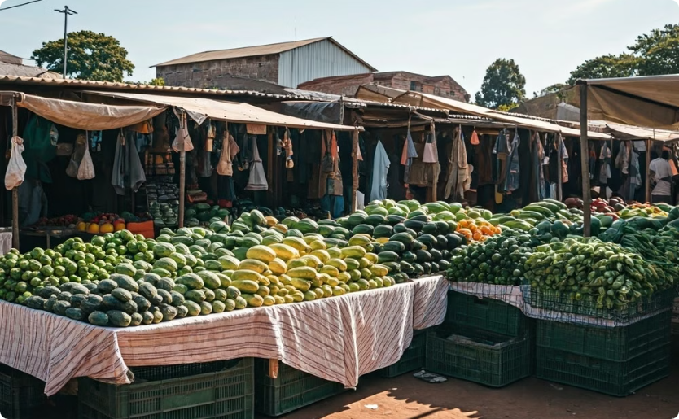

Market Opportunity
Target Audience
Potential for Growth
VibandaConnect is designed for local fruit and vegetable vendors in Kenya, especially those operating informally along roadsides.
As Kenya's digital economy flourishes, small-scale vendors are increasingly eager to adopt simple tech solutions that boost their business efficiency.

Slide 5
Product Overview
Key Features
Benefits
Vendor Dashboard: Manage products, view orders, and track sales.
Efficiency: Simplifies order and delivery management.
Accessibility: Designed to be user-friendly and intuitive.
Customer Portal: Place orders with preferred vendors.
Rider Dashboard: Access orders for pickup and delivery.
Scalability: Allows for potential expansion to more complex features as needs grow.

Slide 6
Revenue Model
Subscription Model
Transaction Fee
Sponsorships and Partnerships
Small, affordable monthly fee for access to the system.
Percentage fee on each completed transaction.
Collaboration with local businesses or NGOs interested in supporting small vendors.
Positioned as low-cost to ensure adoption by the target market.

Slide 7




Technology Stack
Database
Backend
Frontend
Deployment Options
MySQL is used for structured data management.
Node.js and Express are used for handling API requests and server logic.
HTML, CSS, JavaScript are used for building the customer, vendor, and rider interfaces.
VibandaConnect can be deployed locally or in the cloud, depending on the scalability needs.

Slide 8
Competitors
Jumia Food
Glovo
Kapu
Twiga Foods
Strengths: Brand recognition, diverse product range.
Strengths: Strong logistics, real-time tracking.
Strengths: Affordable, bulk buying for low-income customers.
Strengths: Strong supply chain for fresh produce.
Limitations:
Limitations:
Limitations:
Limitations:
B2B focus, no customer-facing order management.
Targets formal vendors, higher service fees.
Focus on urban, tech-savvy customers; high delivery costs.
Targets groups, lacks real-time delivery features.

Slide 9
Competitive Advantage
User-Friendly
Niche Focus
Affordable
Local Delivery
Simple setup, no technical expertise needed.
Tailored for small-scale, informal vendors (mama wa vibanda).
Low-cost, accessible to low-margin vendors.
Integrates local riders for fast, same-day delivery.
Vendor Control
Growth Potential
Full control over inventory, orders, and customer relationships.
Can expand with features like digital payments, analytics, and bulk ordering.

Slide 10

Traction and Validation
Pilot Testing: Outline plans to conduct a pilot test with a small group of vendors to validate the concept and gather feedback.
Expected Outcomes: Improved order management efficiency, quicker deliveries, and customer satisfaction.
User Feedback: Plan to collect feedback to refine the solution and address any challenges.

Slide 11



Go-to-Market Strategy
Initial Launch
Roll out the app in urban and peri-urban areas where there is a concentration of vendors and potential customers.
Marketing Channels
Collaborations with community leaders and vendor associations.
Demonstration days where vendors can try the system.
Partnerships with local motorcycle rider groups.
Customer Support
A helpline or chatbot support to assist with any technical issues.

Slide 12

Roadmap & Milestones
1
Short-Term
Finalize MVP (Minimum Viable Product) and conduct initial testing.
2
Mid-Term
Expand feature set based on feedback.
Increase user base through marketing efforts.
3
Long-Term
Introduce advanced features (like payment integration) and expand to additional regions.

Slide 13

Call To Action
VibandaConnect transforms informal markets with cutting-edge order management technology. We empower local vendors to thrive in the digital age.
We encourage you to join us in this venture and join in scaling the solution.
Contact me at hananmohamudy@gmail.com.

